Slide 1

CMR TECHNICAL CAMPUS
Department of Information Technology
Major Project Stage-II Review-II
A Centralized Student-Faculty Platform for Real-Time Academic Performance Prediction
Presented By:
Batch No:23
M Anjali(227R1A1236)
G Abhinav(237R5A1204)
M Akhila Kumari(227R1A1238)
Project Supervisor:
Name : D Mahesh Babu
Designation : Assistant Professor

Slide 2
INDEX
INTRODUCTION AND OVERVIEW
EXISTING SYSTEM
DISADVANTAGES
PROPOSED SYSTEM
ADVANTAGES
HARDWARE AND SOFTWARE REQUIREMENTS
NOVELTY OF PROJECT
ARCHITECTURE
MODULES
UML DIAGRAMS
SOURCE CODE
RESULTS
CONCLUSION & FUTURE ENHANCEMENT
REFERENCES
GITHUB LINK

Slide 3
INTRODUCTION AND OVERVIEW
The accurate monitoring and prediction of student performance is essential for enhancing learning outcomes and enabling data-driven academic decisions. Traditional academic management systems primarily function as static repositories for grades and attendance records, lacking predictive analytics capabilities. Moreover, such systems often do not provide integrated communication channels among administrators, faculty, students, and parents, limiting their effectiveness in improving student engagement and support. This work presents a centralized student portal that leverages machine learning (ML) algorithms to analyze historical academic data and predict individual student performance. Both models are trained on past student marks, and performance is evaluated using accuracy, precision, recall, and F1 score.

Slide 4
EXISTING SYSTEM
The existing system used in many educational institutions is primarily based on manual or semi-digital academic management methods. Academic data such as student marks, attendance, and assignments are stored in registers, spreadsheets, or separate software applications. These systems mainly act as data storage tools without providing advanced analytical capabilities.
Faculty members manually maintain attendance records and evaluate student performance by reviewing marks and assignments individually. Communication between students and faculty often takes place through emails or messaging applications, which are not integrated into a single system.
Since the data is distributed across multiple platforms, it becomes difficult for administrators and faculty to get a complete view of student performance. Additionally, these systems do not use any machine learning or predictive techniques, making it hard to identify students who need early academic support.

Slide 5
DISADVANTAGES
No Predictive Analysis The system only stores data and does not analyze it. There is no prediction of student performance,
so early identification of weak students is not possible.
Lack of Centralization Academic data is stored in multiple places (registers, files, or different systems), making it difficult to access
and manage efficiently.
Time-Consuming Manual Work Faculty must manually analyze marks and attendance, which is slow and prone to human errors.
Poor Communication System Communication happens through separate platforms like email or messages, leading to unstructured and
fragmented communication.

Slide 6
PROPOSED SYSTEM
Uses machine learning algorithms like Naïve Bayes and XGBoost to analyze historical student data and
predict academic performance.
Allows real-time monitoring of student progress and academic activities.
A web-based centralized system that stores all academic data such as marks, attendance, assignments,
and feedback in a single database.
Provides separate access for admin, faculty, and students with role-based functionalities.
Enables faculty to upload marks, attendance, assignments, and study materials through the platform.
Helps identify students who may need additional academic support at an early stage using predictive analysis.
Improves communication between students and faculty through messaging and notifications.
Generates academic reports and performance insights to support better decision making.
Includes a feedback system where students can review faculty performance.

Slide 7
ADVANTAGES
Centralized Data Management:
The system integrates attendance, marks, assignments, and faculty feedback into a single unified
platform, eliminating fragmented data storage and improving transparency in academic monitoring.
Machine Learning-Based Prediction:
The use of algorithms such as Naïve Bayes and XGBoost enables accurate prediction of
student performance categories, helping faculty identify academically at-risk students at an early stage.
Improved Academic Monitoring:
The centralized dashboard allows administrators and faculty members to track student
progress, analyze academic trends, and generate performance reports efficiently.

Slide 8
SOFTWARE REQUIREMENTS
HARDWARE REQUIREMENTS
Operating System :Windows 11
Framework :Dijango famework
Database : MySQL
Machine Learning Libraries : Scikit-learn, XGBoost,
NumPy, Pandas
Processor :Intel Core i5
RAM :16 GB
Hard disk :512 SSD

Slide 9
NOVELTY OF PROJECT
The novelty of this project lies in the integration of a centralized academic management system with real-time machine learning–based performance prediction. Unlike traditional systems that only store academic data, this platform not only manages data such as marks, attendance, and assignments but also analyzes it to generate predictive insights about student performance. The use of advanced algorithms like Naïve Bayes and XGBoost enables early identification of academically at-risk students, allowing timely intervention. Additionally, the system combines prediction, communication, and academic management into a single platform with role-based dashboards for admin, faculty, and students. Features such as real-time feedback, faculty performance evaluation, and a structured communication system further enhance its uniqueness. This combination of data centralization, predictive analytics, and interactive features makes the project more intelligent, efficient, and innovative compared to existing academic systems.

Slide 10

MODULES
Student and Faculty Registration Module: Manages the registration and login of students and faculty members into the system. Academic Data Management Module: Allows faculty to upload and manage marks, attendance, and assignments. Data Preprocessing Module: Cleans and organizes the collected academic data for analysis. Machine Learning Prediction Module: Uses algorithms like Naïve Bayes and XGBoost to predict student performance. Dashboard and Visualization Module: Displays academic details, reports, and predictions through user dashboards. Communication Module: Enables messaging and interaction between students and faculty. Performance Report Generation Module: Generates reports based on student performance and prediction results.

Slide 11
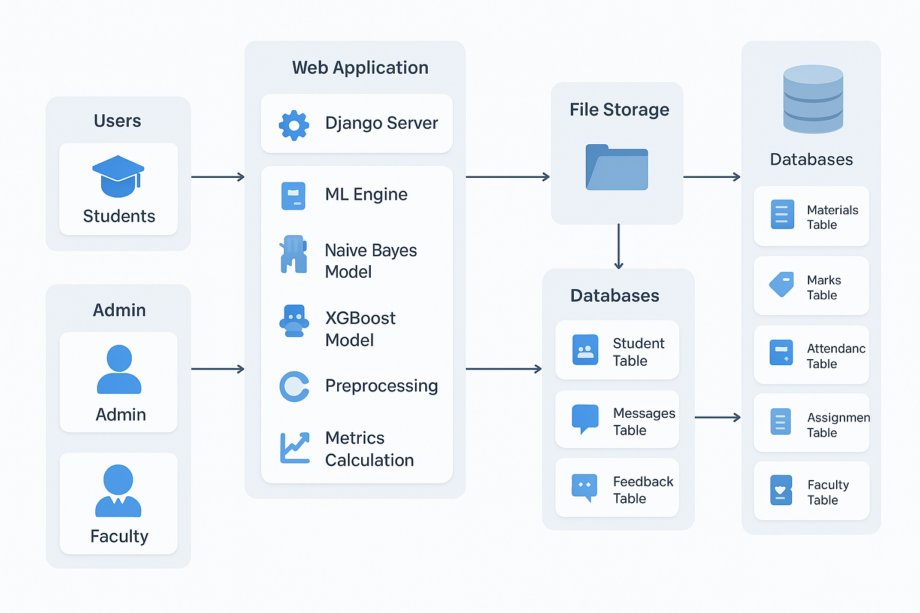
SYSTEM ARCHITECTURE
This project architecture illustrates the workflow followed in the Centralized Student Faculty Platform for Real-Time Academic Performance Prediction, starting from data collection to final prediction of student performance.

Slide 12
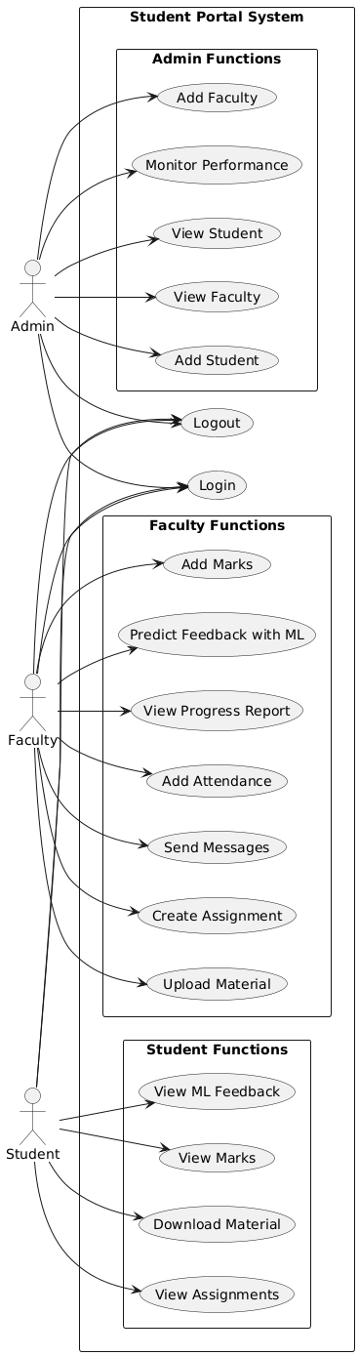
UML DIAGRAMS
USE CASE DIAGRAM:

Slide 13
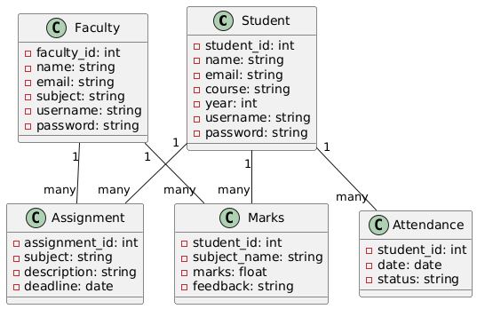
CLASS DIAGRAM

Slide 14
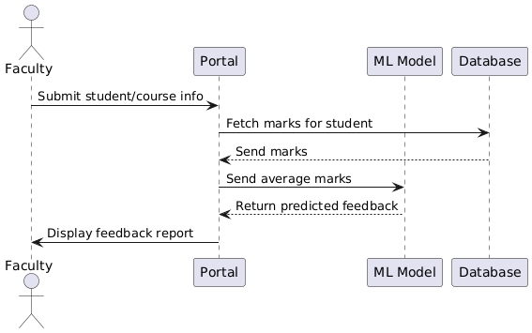
SEQUENCE DIAGRAM:

Slide 15
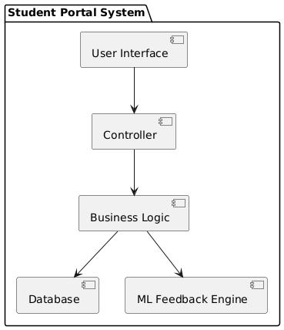
COMPONENT DIAGRAM:

Slide 16
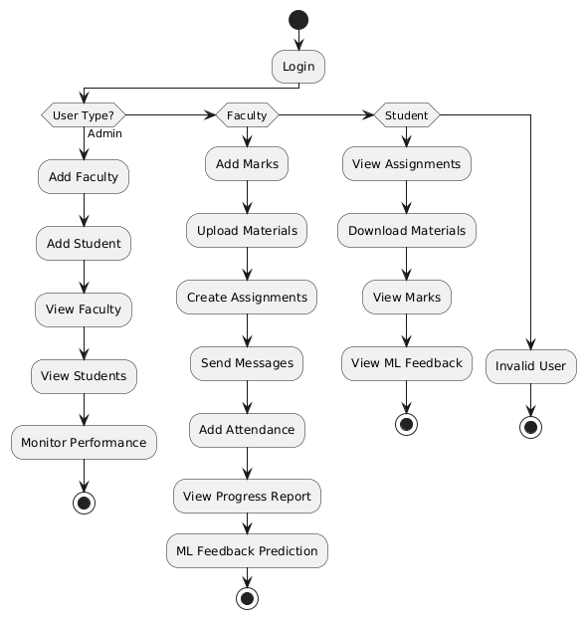
ACTIVITY DIAGRAM:

Slide 17
# views.py (Django Backend)
from django.shortcuts import render
from .models import Student
def home(request):
return render(request, "index.html")
def add_student(request):
if request.method == "POST":
name = request.POST.get("name")
marks = request.POST.get("marks")
student = Student(name=name, marks=marks)
student.save()
return render(request, "success.html")
return render(request, "add_student.html")
SAMPLE CODE:

Slide 18
import pandas as pd
# Load dataset
data = pd.read_csv("student_data.csv")
# Handle missing values
data.fillna(0, inplace=True)
# Feature selection
X = data[['marks', 'attendance']]
y = data['performance']
print(X.head())

Slide 19
from sklearn.model_selection import train_test_split
from sklearn.naive_bayes import GaussianNB
from sklearn.metrics import accuracy_score
# Split data
X_train, X_test, y_train, y_test = train_test_split(X, y, test_size=0.2)
# Model training
model = GaussianNB()
model.fit(X_train, y_train)
# Prediction
y_pred = model.predict(X_test)
# Accuracy
print("Accuracy:", accuracy_score(y_test, y_pred))

Slide 20
from xgboost import XGBClassifier
# Create model
xgb = XGBClassifier()
# Train model
xgb.fit(X_train, y_train)
# Predict
y_pred = xgb.predict(X_test)
# Accuracy
from sklearn.metrics import accuracy_score
print("XGBoost Accuracy:", accuracy_score(y_test, y_pred))

Slide 21
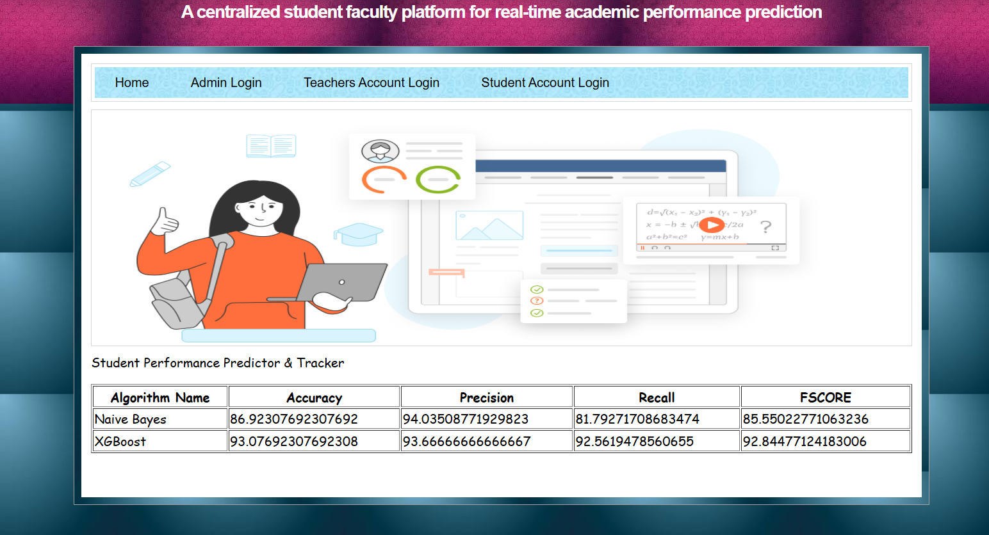
RESULTS:
1. Interface overview

Slide 22
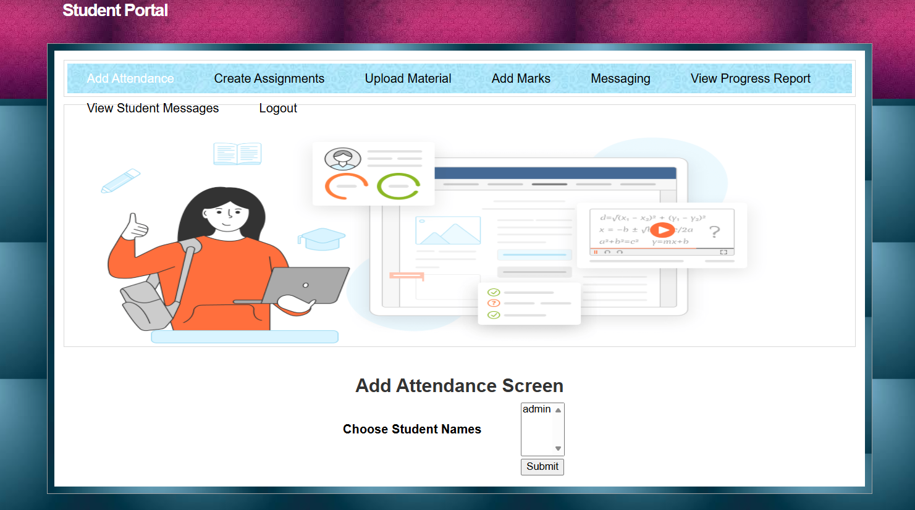
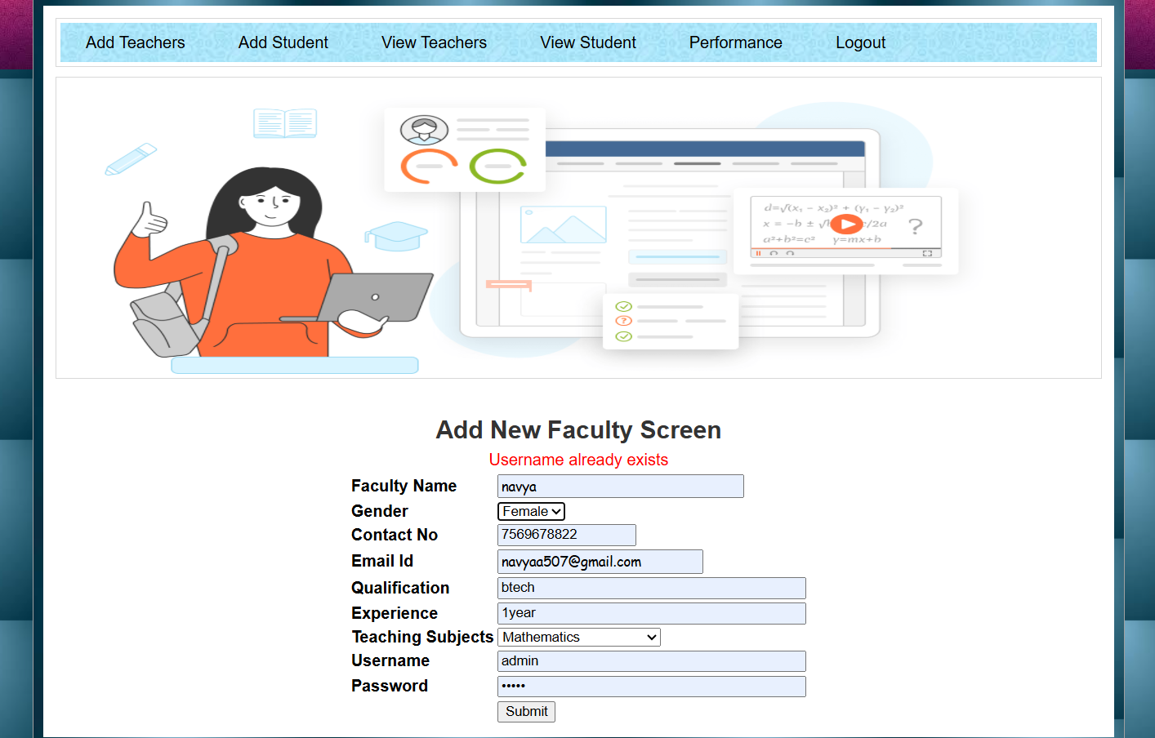
3.Teacher uploading student attendance
2.Uploading teacher details

Slide 23
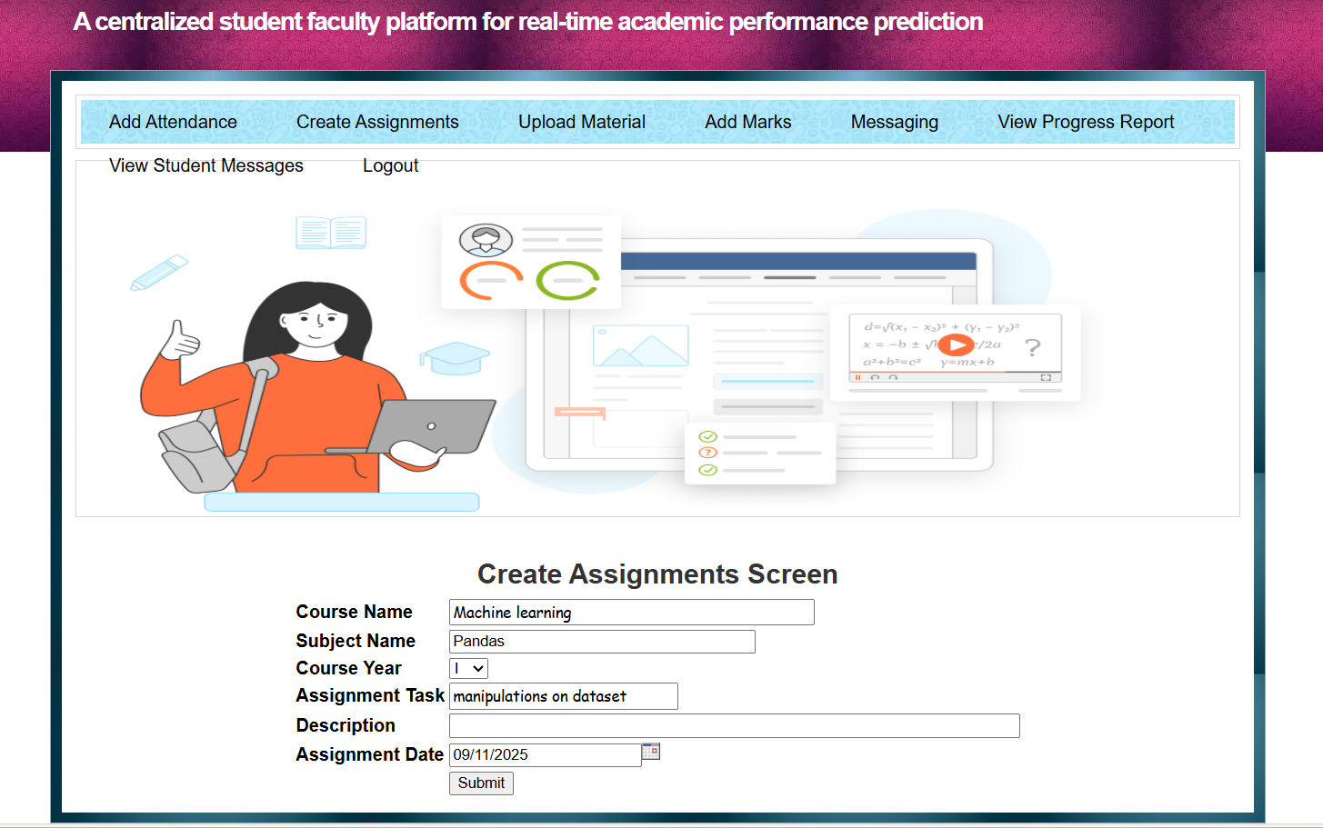
4.Teacher creating assignments

Slide 24
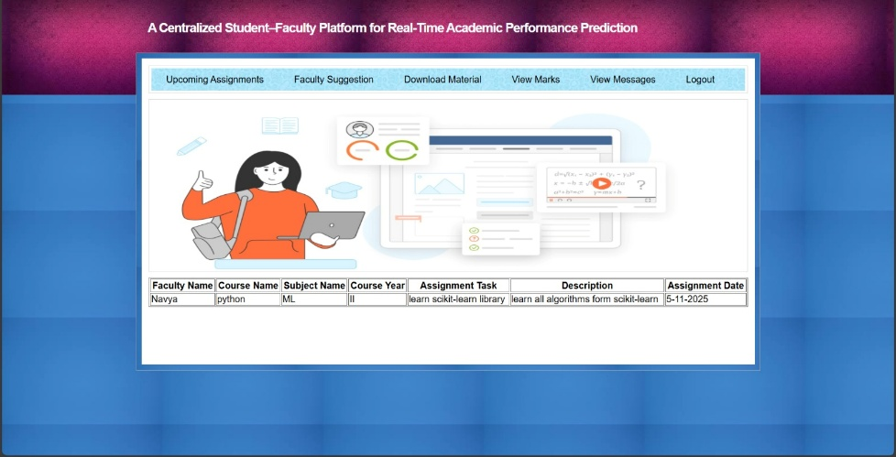
5.Student checking assignments

Slide 25

6.Student downloading learning materials

Slide 26
CONCLUSION & FUTURE ASPECTS
In this research, a Centralized Student–Faculty Platform for Real-Time Academic Performance Prediction was successfully developed. The study demonstrated the effectiveness of integrating machine learning techniques with centralized academic data management to monitor and predict student performance. The proposed system utilized algorithms such as Naïve Bayes and XGBoost to analyze student academic data including marks, attendance, and assignments. The models were evaluated using performance metrics such as accuracy, precision, recall, and F1-score to measure prediction performance. Among the algorithms used, the XGBoost classifier achieved better prediction accuracy compared to the Naïve Bayes model, showing its effectiveness for analyzing academic data. The improvement in prediction capability is due to the ability of machine learning algorithms to identify patterns in historical academic records.

Slide 27
FUTURE ASPECTS
Although the proposed system performed effectively, there are several opportunities for future improvement. The dataset used for training the machine learning models can be expanded with more academic records from different departments and institutions to improve prediction accuracy. Future work can also focus on integrating additional machine learning techniques such as Artificial Neural Networks and Random Forest algorithms to enhance prediction performance. Including more academic features such as attendance patterns and assignment completion data can further improve the system’s analytical capabilities.

Slide 28
[1] Kezar, A.; Kitchen, J.A.; Estes, H.; Hallett, R.; Perez, R. Tailoring programs to best support
low-income, first-generation, and racially minoritized college student success. J. Coll. Stud.
Retent. Res. Theory Pract. 2023, 25, 126–152.
[2] Wilmer, E. Student support services for the underprepared student. Inq. J. Va. Community Coll. 2008, 13, 4–19.
[3] Andrews, R.J.; Imberman, S.A.; Lovenheim, M.F. Recruiting and supporting low-income,
high-achieving students at flagship universities. Econ. Educ. Rev. 2020, 74, 101923.
[4] Hoyt, J.E. Student connections: The critical role of student affairs and academic support services
in retention efforts. J. Coll. Stud. Retent. Res. Theory Pract. 2023, 25, 480–491.
[5] Kuh, G.D. Student success. In Student Services: A Handbook for the Profession, 5th ed.; Schuh,
J.H., Jones, S.R., Harper,S.R., Eds.; Jossey-Bass: Hoboken, NJ, USA, 2011; pp. 257 270.
REFERENCES

Slide 29
[6] Alruwais, N.; Zakariah, M. Evaluating Student Knowledge Assessment Using Machine Learning Techniques. Sustainability 2023, 15, 6229. https://doi.org/10.3390/su15076229.
[7] Oliveira, P.F.; Matos, P. Introducing a Chatbot to the Web Portal of a Higher Education Institution to Enhance Student https://doi.org/10.3390/ASEC2023-16621. Interaction. Eng. Proc. 2023, 56, 128.
[8] Imundo, M.N.; Goldshtein, M.; Watanabe, M.; Gong, J.; Crosby, D.N.; Roscoe, R.D.; Arner, T.; McNamara, D.S. Awareness to Action: Student Knowledge of and Responses to an Early Alert System. Appl. Sci. 2025, 15, 6316. https://doi.org/10.3390/app15116316.
[9] Guanin-Fajardo, J.H.; Guaña-Moya, J.; Casillas, J. Predicting Academic Success of College Students Using Machine Learning Techniques. Data 2024, 9, 60. https://doi.org/10.3390/data9040060.
[10] Learning Techniques. Data 2024, 9, 60. Syed Mustapha, S.M.F.D. Predictive Analysis of Students’ Learning Performance Using Data Mining Techniques: A Comparative Study of Feature Selection Methods. Appl. Syst. Innov. 2023, 6, 86. https://doi.org/10.3390/asi6050086.

Slide 30
GITHUB LINK
https://github.com/mashapathrianjali03/Major-Project---A23

Slide 31
THANK YOU

